Slide 1
Investigating the collapsar model using simulation
James Wright
Notes:
This is a presentation on the investigation into the collapsar model using simulation
The collapsar model describes the process and conditions required to produce gamma-ray bursts

Slide 2
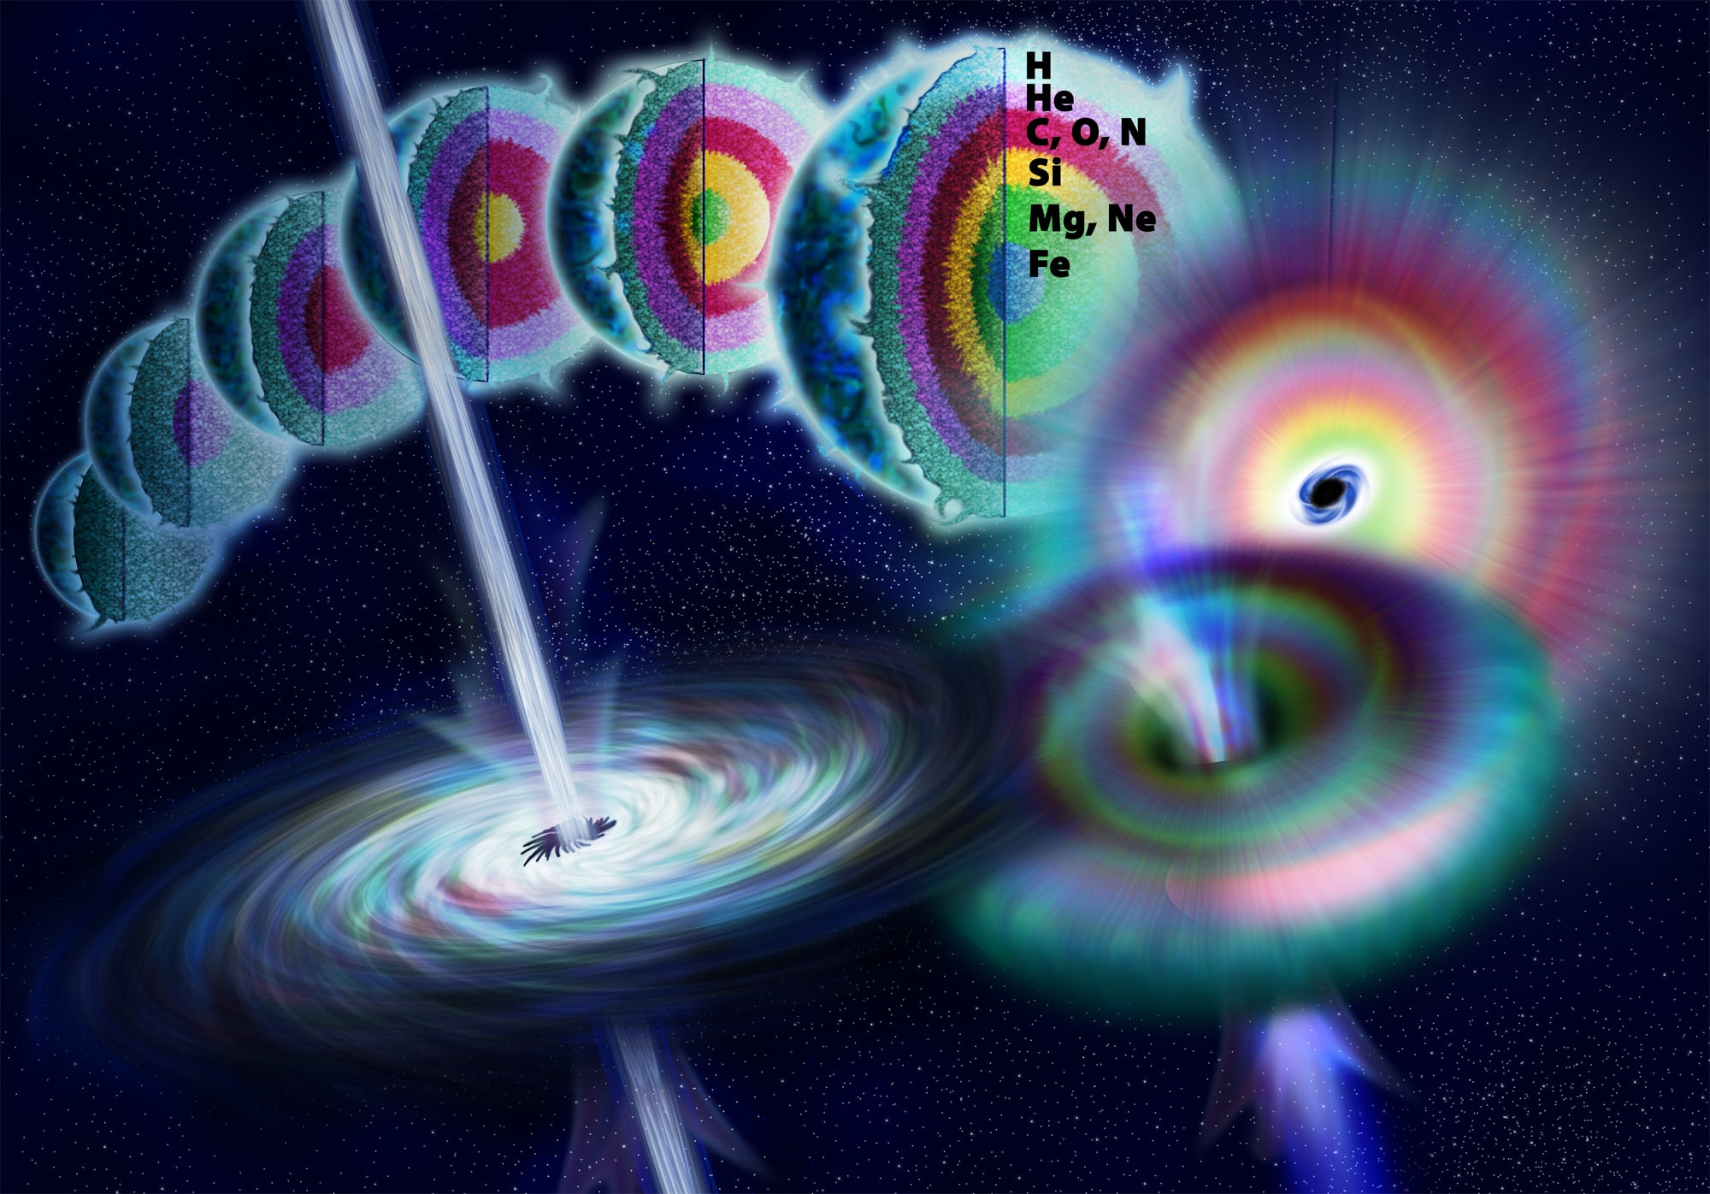
Introduction
What are gamma-ray bursts?
How are GRBs produced?
Why are GRBs important?
Why is the collapsar model important?
Gamma-ray burst - Wikipedia
Notes:
Gamma-ray burst (GRBs) are the most luminous explosions in the universe, there are short and long GRBs, with the long type lasting longer than 2 secs, these are what we are talking about
Long GRBs are associated with the deaths of massive stars, which we will go into more detail with the collapsar model next
They’re important because their afterglows illuminate their host galaxies, making them useful for probing these distant galaxies for info about their ISM, and the evolution of the galaxy
This is also why the collapsar model is important, because it suggests necessary properties of the progenitor stars that produce GRBs, so if the model is correct, when we observe one we can already assume certain things about the galaxy and region that it comes from

Slide 3
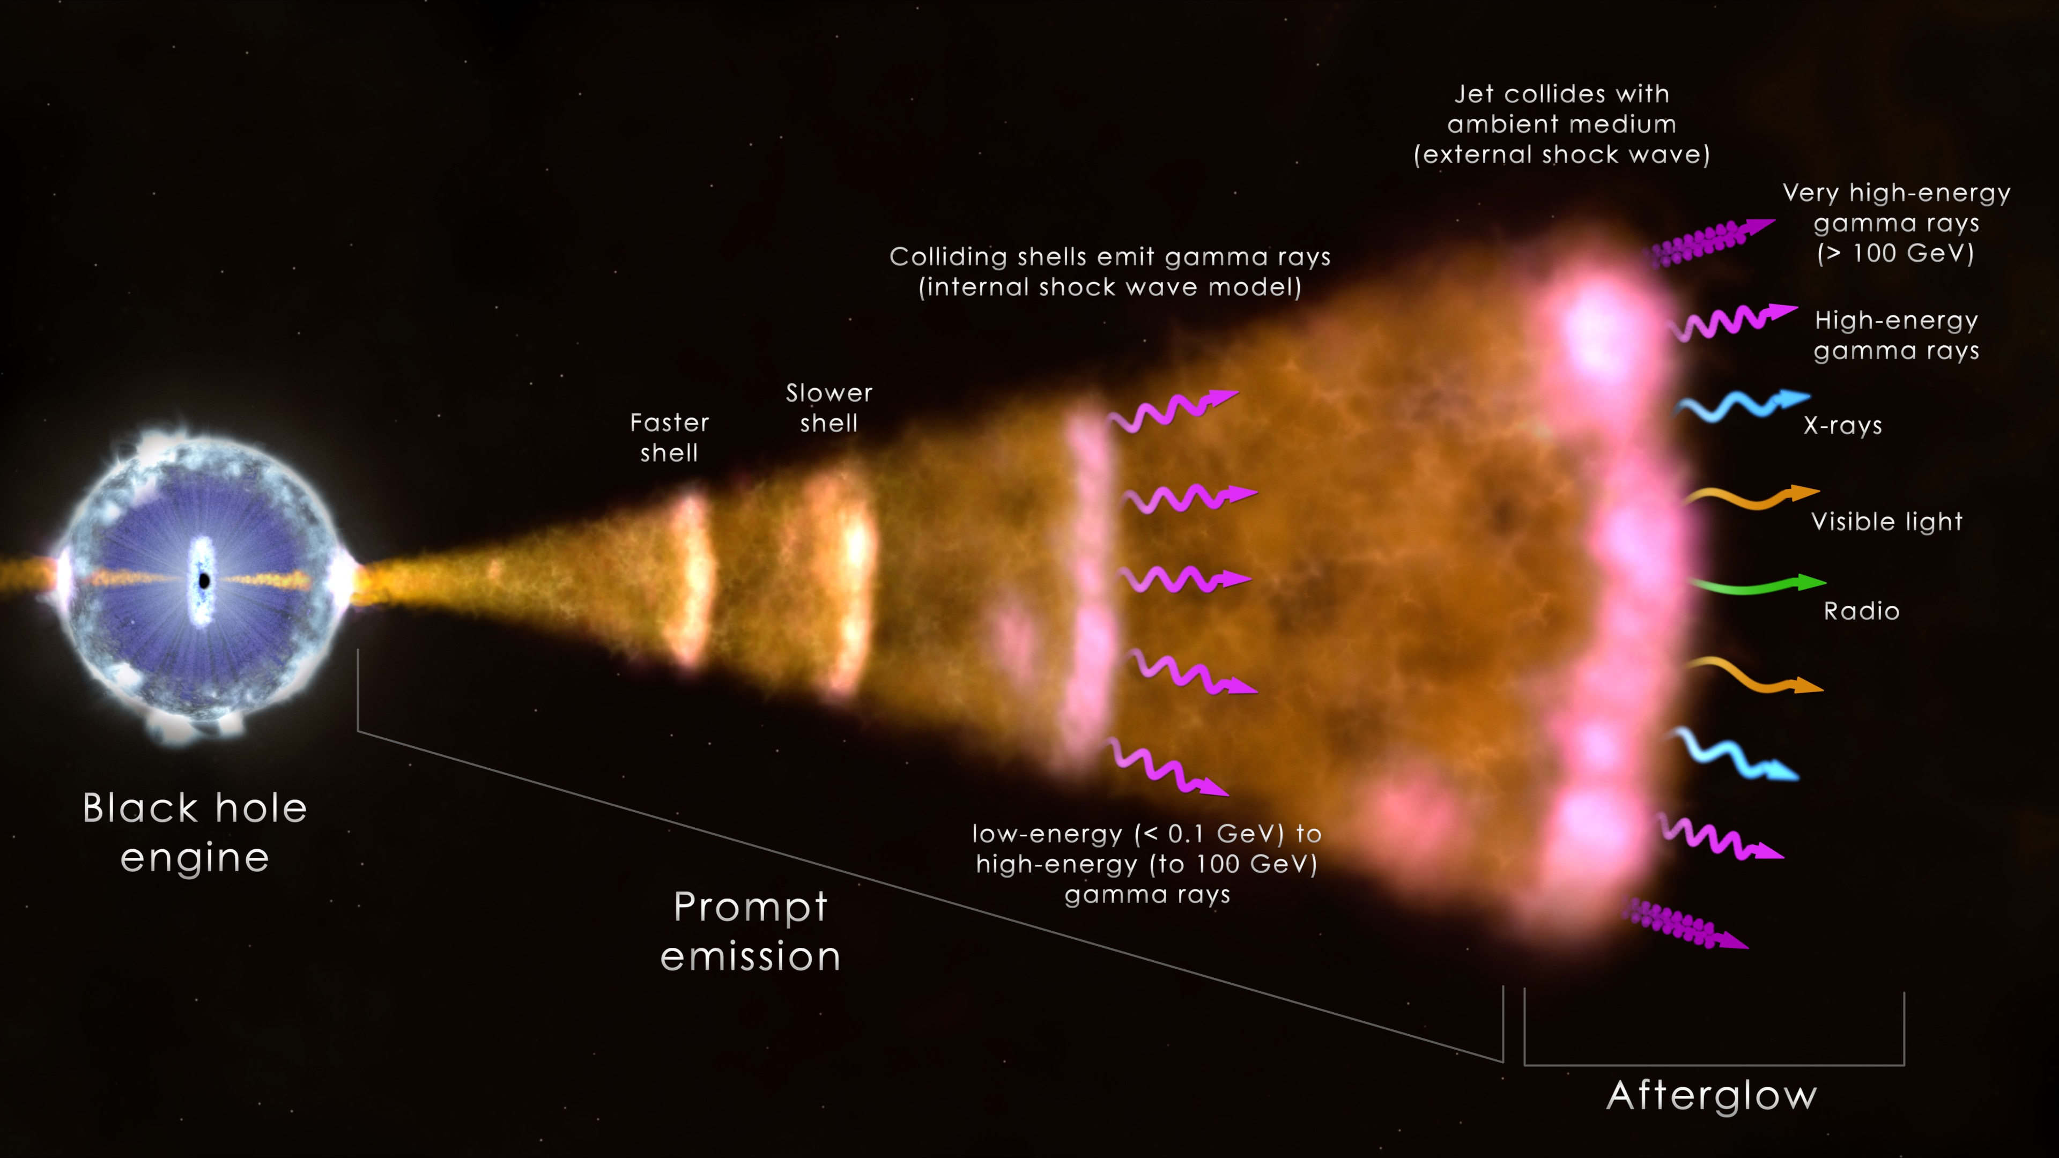
Collapsar model (Woosley 1993)
Accreting black holes
Relativistic jets
GRB prompt emission
Afterglow emission
SN emission
Gamma-ray burst - Wikipedia
Notes:
Core collapse of a massive (25-35 M⊙) fast-rotating star into a black hole
Angular momentum helps form accretion disk of excess material
This accretion produces relativistic jets of plasma
Plasma moving at different speeds and collides with itself
Front of jet collides with ISM for afterglow (lower frequency)
Black hole associated with a core collapse supernova, so we also detect the thermal emission from the material ejected from the star
But the SN is generally not observed until after GRB has faded

Slide 4
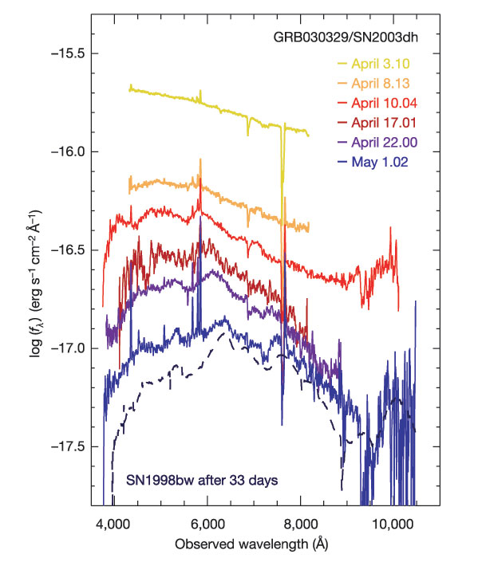
Key observations
Afterglow first observed – GRB 970228 (Wijers et al. 1997)
Closest GRB ever detected – GRB 980425 (Galama et al. 1998)
GRB 030329 was followed by SN 2003dh (Hjorth et al. 2003)
Hjorth et al. 2003
Notes:
Afterglow predicted in 1993, observed in 1997
(Redshift of z = 0.085) GRB was quite strange as its light was drowned out by its associated supernova, so this wasn’t really conclusive evidence that the two things are associated in the way that the collapsar model predicts
In 2003 is the GRB and its spectrum is showed here where you can see the GRB at the top, and as time passed we saw the SN and this confirmed LGRBs are associated with the death of a massive star

Slide 5
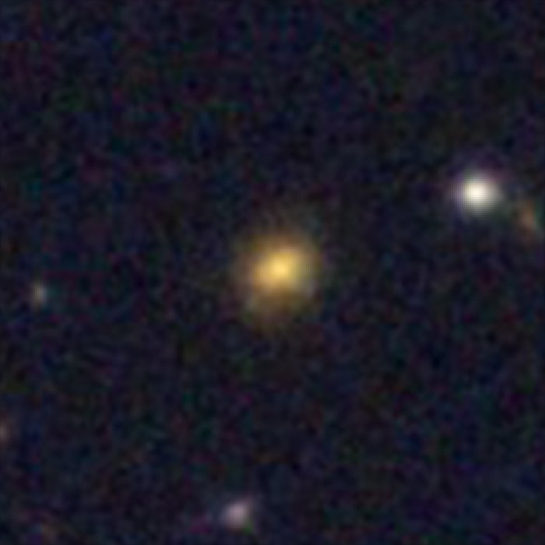
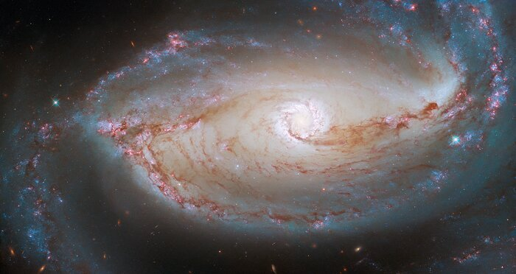
The metallicity problem
Wind-driven mass-loss ∝ metallicity^{0.5} (Woosley et al. 2006)
Metallicity limit - 0.3 Z⊙ (Woosley et al. 2006)
z = 0.005
z = 2
ESA/Hubble & NASA, Sand et al.
NASA, ESA, Papovich et al.
Notes:
Mass loss – angular momentum loss
Angular momentum required to maintain accretion disk
Accretion disk feeds the jets that cause the GRB
Above 0.3solar, too much angular momentum is lost for the GRB to occur
However we cannot measure the metallicity of the stars or regions that produce these GRBs
50 million LY vs 10.3 billion LY (both taken with the same camera)
Most GRBs are at these distances, so cannot measure metallicity of the star or local region as we don’t have the spatial resolution for it
So we measure the metallicity for the whole host galaxy, by basically putting a slit over it in the sky
And it’s the gas-phase metallicity of these host galaxies that we measure instead, using the ratios of emission lines from the gas

Slide 6
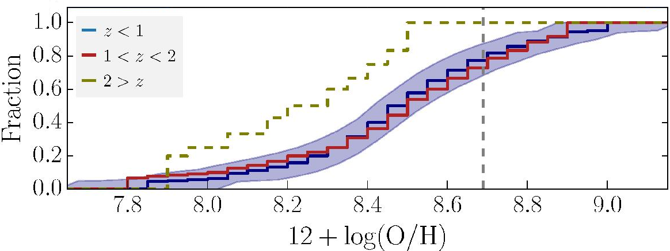
Host galaxy metallicity distribution
Recent study: ~ 90% of host galaxies with Z > 0.3 Z⊙
Observation contradicts with theory
Kruhler et al. 2015
Notes:
Study from 2015, this is cumulative, so if you look at this black line which is 0.3solar in these units that means only a bit over 10% are below the theoretical limit
Contradiction between observation and theory

Slide 7
Hypothesis
Long gamma-ray bursts occur in metal-poor regions of metal-rich galaxies
Notes:
Assume observations are accurate, and that LGRBs occur in metal-poor regions of metal-rich galaxies
Observational techniques are limited, will use simulation instead, more specifically IllustrisTNG

Slide 8
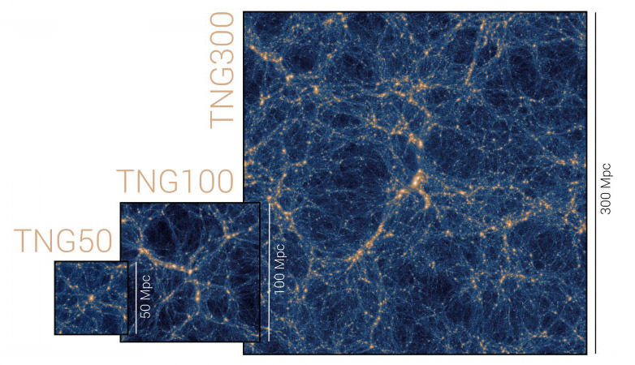
Simulation – IllustrisTNG
Required a large volume and a good spatial resolution
Three different simulation volumes, TNG50, TNG100 and TNG300
Different resolution levels for each
(Nelson et al. 2019a)
Notes:
Large volume for lots of galaxies, good spatial resolution for as many SF cells as possible within galaxies
IllustrisTNG met this criteria
3 different simulation volumes as shown in the figure, number = box side length in Mpc

Slide 9
IllustrisTNG
Required highest resolution possible
TNG50-1 was therefore chosen (Nelson et al. 2019b & Pillepich et al. 2019)
Run | L_{box} [cMpc / h] | N_{GAS,DM} | m_{baryon} [10⁶ M⊙] | m_{DM} [10⁶ M⊙]
TNG50-1 | 35 | 2160³ | 0.08 | 0.45
TNG50-2 | 35 | 1080³ | 0.68 | 3.63
TNG100-1 | 75 | 1820³ | 1.4 | 7.5
TNG300-1 | 205 | 2500³ | 11 | 59
Nelson et al. 2019a
Notes:
So because we’re investigating singular stellar events, we wanted the highest resolution possible
Table shows key properties of four selected TNG simulations, and the one with the smallest particle mass therefore had the highest mass resolution
Which is why we chose TNG 50-1 for this investigation

Slide 10
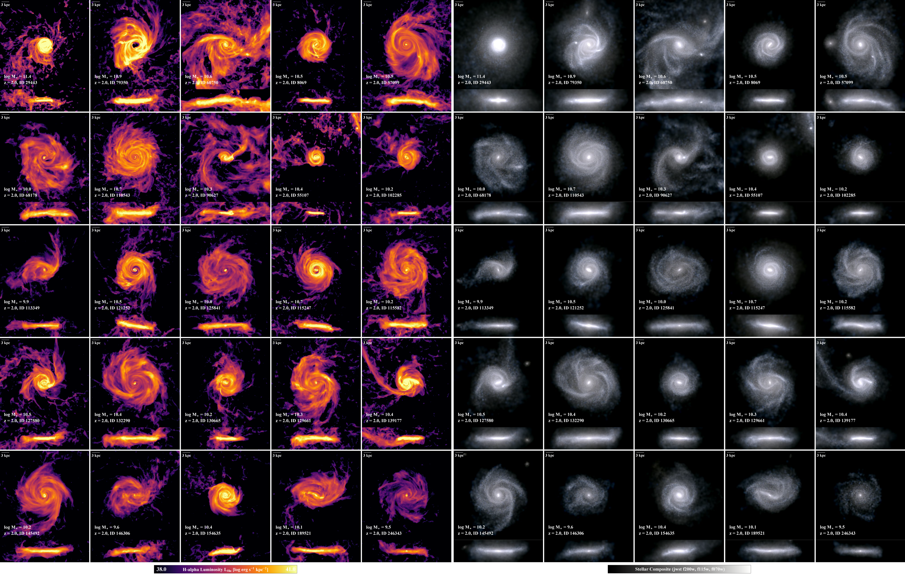
Snapshots, subhalos and particles
(Pillepich et al. 2019)
Notes:
This image demonstrates what subhalos or galaxies look like in TNG, this is at redshift 2, left side is gas, right side is optical light from stars
Data in TNG is organised into 100 snapshots at different redshifts
Each snapshot has a catalogue of subhalos, or galaxies
Each subhalo has a star formation rate (SFR), mass and metallicity
Mass is divided into DM, gas, stars, BHs
Metallicity divided into stellar and gas components
These properties are available at particle-level as well, each particle contains 1000s of stars

Slide 11
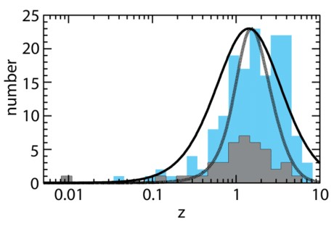
Objective
Create a model that selects galaxies likely to be GRB hosts
Compare results with observations
TNG50-1, snapshot 33 (z ~ 2)
Gehrels et al. 2009
Notes:
Objective is to create a model/system of selecting galaxies likely to be GRB hosts
Then compare our galaxy distribution with with observations
Using TNG50-1 for its resolution, and snapshot 33 because it is at redshift 2, which is the most common redshift for LRGBs as shown in the plot

Slide 12
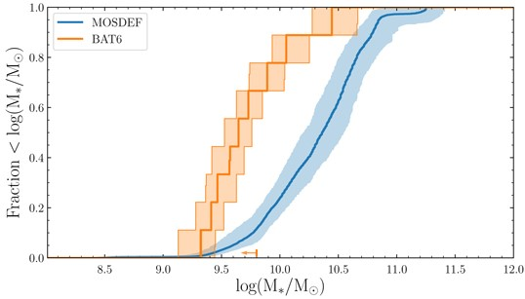
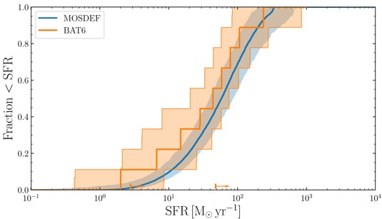
Choosing viable subhalos
Palmerio et al. 2019
Notes:
At this snapshot we wanted to filter out filter out low-mass and low-SFR (passive) galaxies where we would be very unlikely to observe GRBs from IRL
Looking at observation, no GRBs have been observed from galaxies with: stellar mass < 10⁷ M⊙ or SFR < 0.5 M⊙ yr⁻¹, so we can filter these out and this leaves us with a population of viable subhalos

Slide 13
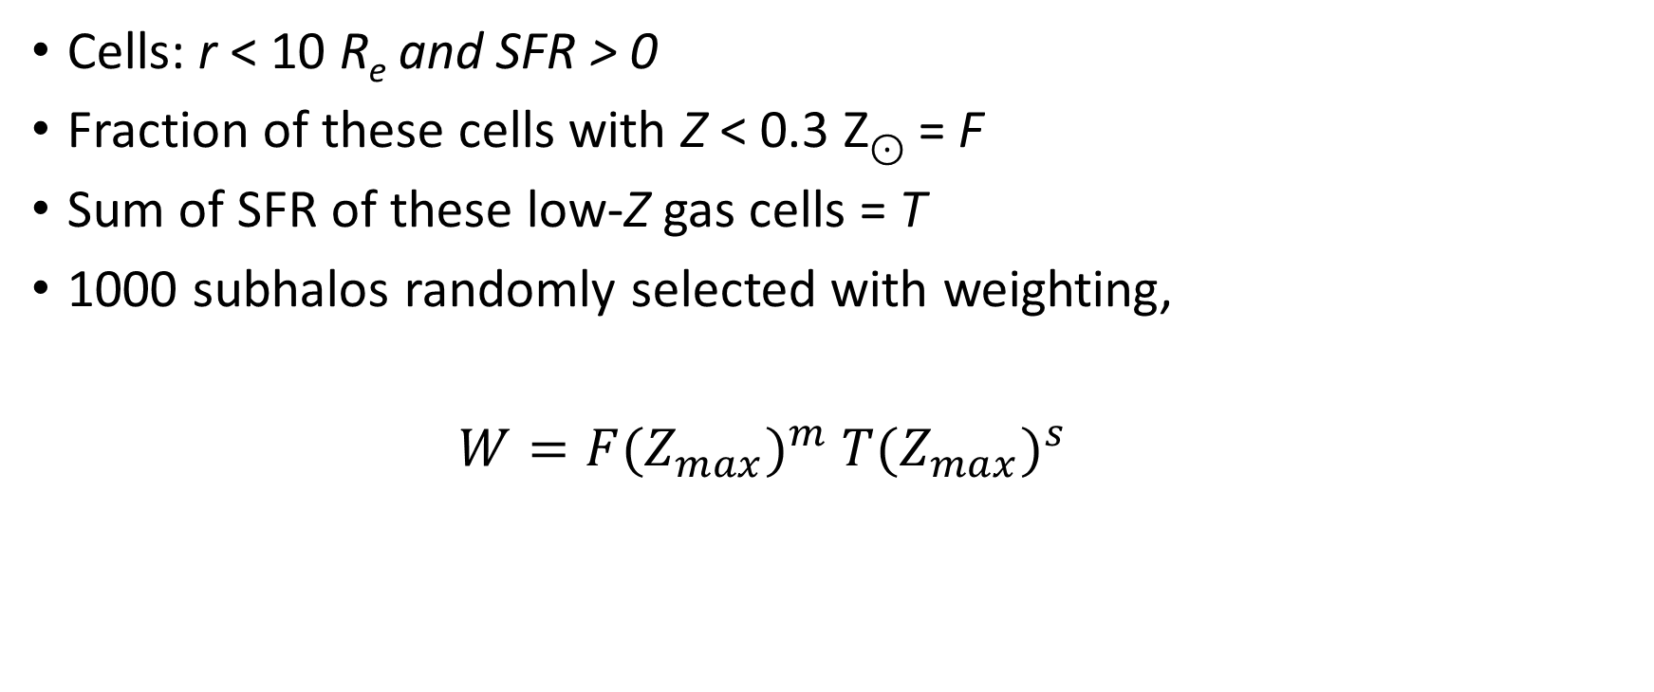
Defining a model
Cells: r < 10 R_{e} and SFR > 0
Fraction of these cells with Z < 0.3 Z⊙ = F
Sum of SFR of these low-Z gas cells = T
1000 subhalos randomly selected with weighting,
$W=F{(Z_{max})}^{m}$ ${T(Z_{max})}^{s}$
Notes:
For each viable subhalo, we filtered the cells to only keep those with in 10 effective radii/stellar half-mass radius from the galaxy centre, this removes any potential passive populations that are outside the galaxy
And we also only kept those with non-zero SFR because GRBs require SF obviously
Out of these cells the fraction with low-metallicity we called F
And the sum of the SFR in these low-metallicity cells we called T
This equation shows the weighting we used for the random selection of 1000 galaxies that we would call GRB hosts
Their values depended on the metallicity limit used (start with 0.3solar) and m and s the exponents can be altered to change how much either the metallicity or the SFR was boosted by

Slide 14
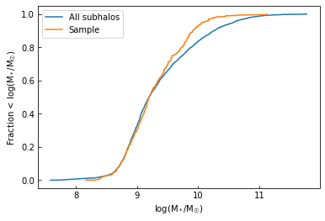
Model 1: Equal weighting
m = s = 1, Z_{max} = 0.3
D-statistic: 0.098
D-statistic: 0.63
Palmerio et al. 2019
Notes:
We plotted CDFs for the metallicity, SFR and stellar mass of this random sample, and also for the entire population of all viable subhalos
K-S test to find statistical difference between these two populations, main result being the D-statistic: the max difference in the y between the samples going across x, ive shown roughly where this is on each plot for this slide
We can then compare these plots and D-values with observation to judge the accuracy of the model

Slide 15
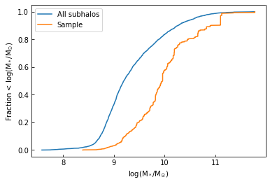
Model 2: SFR-boosted
m = 1, s = 2, Z_{max} = 0.5
D-statistic: 0.465
D-statistic: 0.63
Palmerio et al. 2019

Slide 16
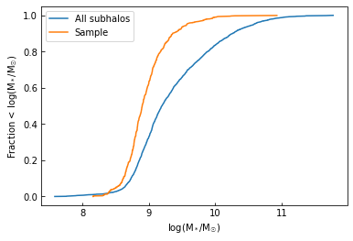
Model 3: metallicity-boosted
m = 2.5, s = 0, Z_{max} = 0.3
D-statistic: 0.324
D-statistic: 0.63
Palmerio et al. 2019

Slide 17
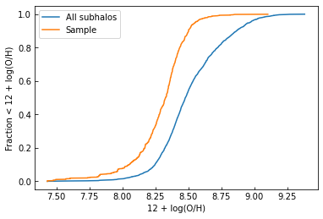
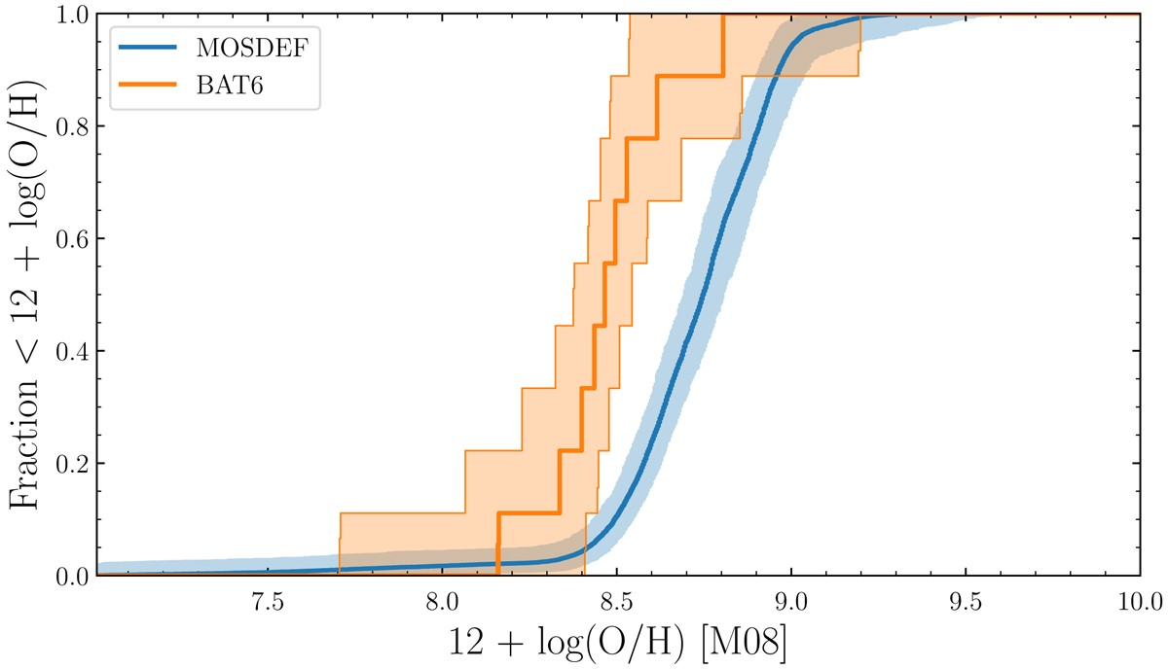
Model 3: metallicity-boosted
m = 2.5, s = 0, Z_{max} = 0.3
D-statistic: 0.389
D-statistic: 0.67
Palmerio et al. 2019

Slide 18
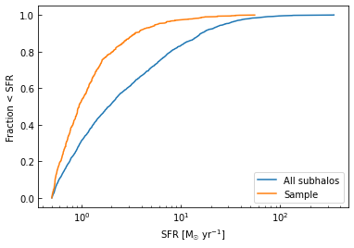
Model 3: metallicity-boosted
m = 2.5, s = 0, Z_{max} = 0.3
D-statistic: 0.295
D-statistic: 0.37
Palmerio et al. 2019

Slide 19
Optimal model compared with observation
Optimal model:
Metallicity = 8.3
SFR = 0.9 M⊙ yr⁻¹
Stellar mass = 10^{8.9} M⊙
Observation: (Palmerio, et al. 2019)
Metallicity = 8.45
SFR = 40 M⊙ yr⁻¹
Stellar mass = 10^{9.6} M⊙
Notes:
Compare the median values of each property, between TNG and observation, we see pretty good agreement for the metallicity, but a big difference in the SFR and this difference then also affects the stellar mass
This significant difference in SFR values, this problem is evident in TNG’s star formation main sequence

Slide 20
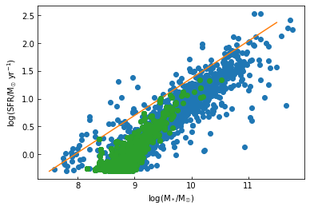
Problems with results - SFR
Observed SFR values much larger than in TNG (Sanders et al. 2018)
Graph shows systematic difference
Problem with theoretical models or measured values (Donnari et al. 2019)
Notes:
Which is this plot here, the orange line is the line of best fit derived from observational data, while the blue dots are our viable subhalos and green dots are our random sample
There is an obvious systematic difference in the SFR at all stellar masses, where the observed is always much higher than in TNG
Now this is either caused by the fundamental limitation of all theoretical models, or because measurements can get contaminated by non-star-forming sources which will inflate the measured value of the SFR

Slide 21
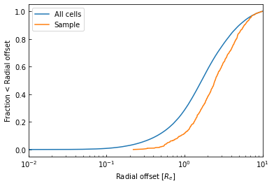
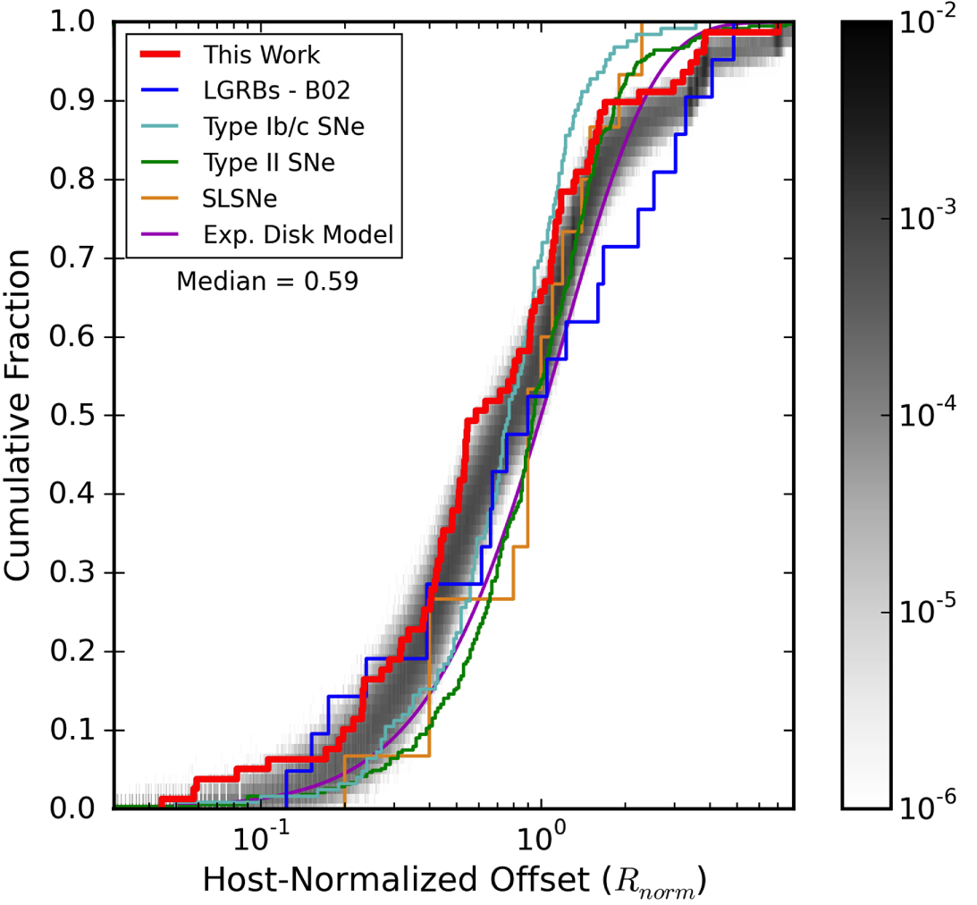
Particle analysis
Particle selection with SFR weighting
Blanchard et al. 2016
Notes:
Randomly selected 1 low-Z cell from each of the 1000 subhalos, using simple linear SFR weighting
Plotted the distribution for the radial offset of the GRB (distance of GRB from the centre of its host galaxy, normalised by the stellar half-mass radius)
The 1 random cell per subhalo is the orange line, the blue line is the entire population of all SF cells in the 1000 galaxy sample
We then compare this with the limited observational data we have for this, TNG predicts an average of 2-3 effective radii, observation gives a value of 0.59 R_{e}

Slide 22
Problems with results – radial offset
Predicted average radial offset (2-3 R_{e}) > observed (0.59 R_{e})
Problem with radial offset measurements
R_{e} definitions are different
Selection problems
NASA, ESA, Papovich et al.
Blanchard et al. 2016
Notes:
So what could be the reason for this difference?
Well we should take absolute measured values with a pinch of salt, but especially for radial offset measurements as resolving these distances at high redshift is very difficult, (remember that image of a galaxy at redshift 2), so there is a lot of uncertainty
Also the definitions of the effective radius is different in each case, in TNG: stellar half-mass radius; in observation: half-light radius, so any dust obscuring starlight will deviate the R_{e} from the SHMR found in TNG
Another reason could be that it’s a problem with our selection process, as we only picked cells with low metallicity and in TNG, particles closer to the galaxy centre are probably too metal-rich to be selected
So if the observations are reliable, and the average offset is closer to the galaxy centre, then this means that GRBs do occur in metal-rich environments
This would therefore then oppose the collapsar model but verification would definitely be needed with more sensitive observations

Slide 23
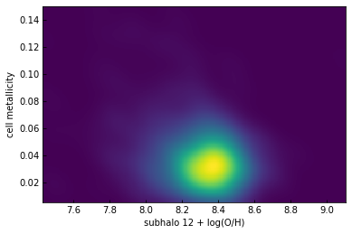
Plotting cell metallicity vs subhalo metallicity
Notes:
Here, for the random sample of 1000 galaxies, we plotted the cell metallicity against the metallicity of that cell’s host galaxy
The cell metallicity is normalised by dividing by the maximum cell metallicity in its galaxy
The densest point in the data suggests that GRBs mostly occur in galaxies with metallicity of roughly 8.35, very close to observation which is impressive
And the average normalised cell metallicity was 0.03, so 3% of the max metallicity in its galaxy, so this would mean that GRBs occur in very metal-poor regions of their galaxies… which was our hypothesis

Slide 24
Hypothesis
Long gamma-ray bursts occur in metal-poor regions of metal-rich galaxies
Notes:
Where if we assume metallicity observations are accurate, as we matched them pretty closely, then we now say that TNG predicts that LGRBs occur in metal-poor regions of metal-rich galaxies

Slide 25
Conclusions
Collapsar model: low metallicity required for LGRBs
Final model:
m = 2.5, s = 0, Z_{max} = 0.3
Model matches theory and observation
Results agree with hypothesis
Future work: finetuning, calibration & spatial resolution improvements
Notes:
Collapsar model predicted that LGRBs require a low metallicity
Optimal model cared more about metal-poor environments than SFR, and this matches the predictions of the collapsar model
Our model also produced results comparable with observation, suggesting there is no contradiction between the collapsar model and observation
This was possible because of our hypothesis which was verified by this plot which shows that GRBs only occur in metal-poor regions of metal-rich galaxies, more specifically an average of 3% of the maximum in its galaxy
This idea will obviously have to be backed up if advancements allow a higher spatial resolution meaning we can measure more-local metallicity then that could verify the collapsar model definitively.

